Slide 1
TOPTICA in Quantum-2 era
Mark A.Tolbert (CEO)
TOPTICA Photonics Inc
Notes:
Hello this is Mark Tolbert from TOPTICA photonics. Today I’m going walk you through the evolution of some of our quantum related products and tell you about how we’ve been pushing the boundaries of the quantum over the past 2 decades.

Slide 2
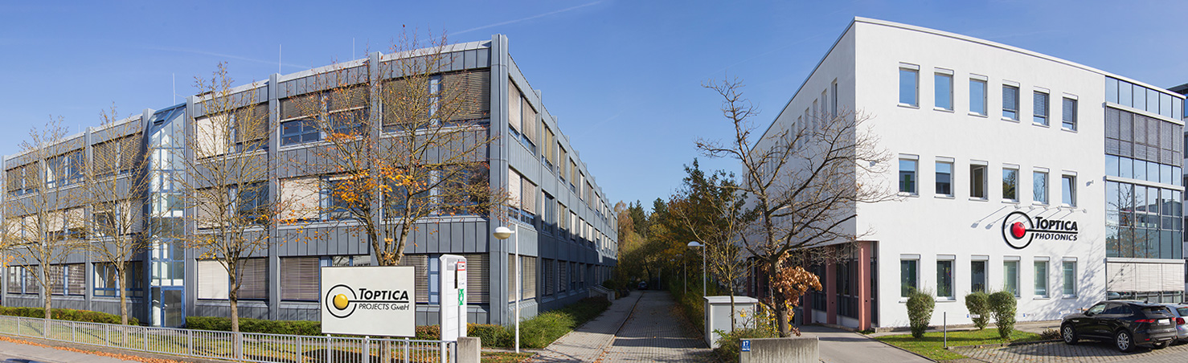
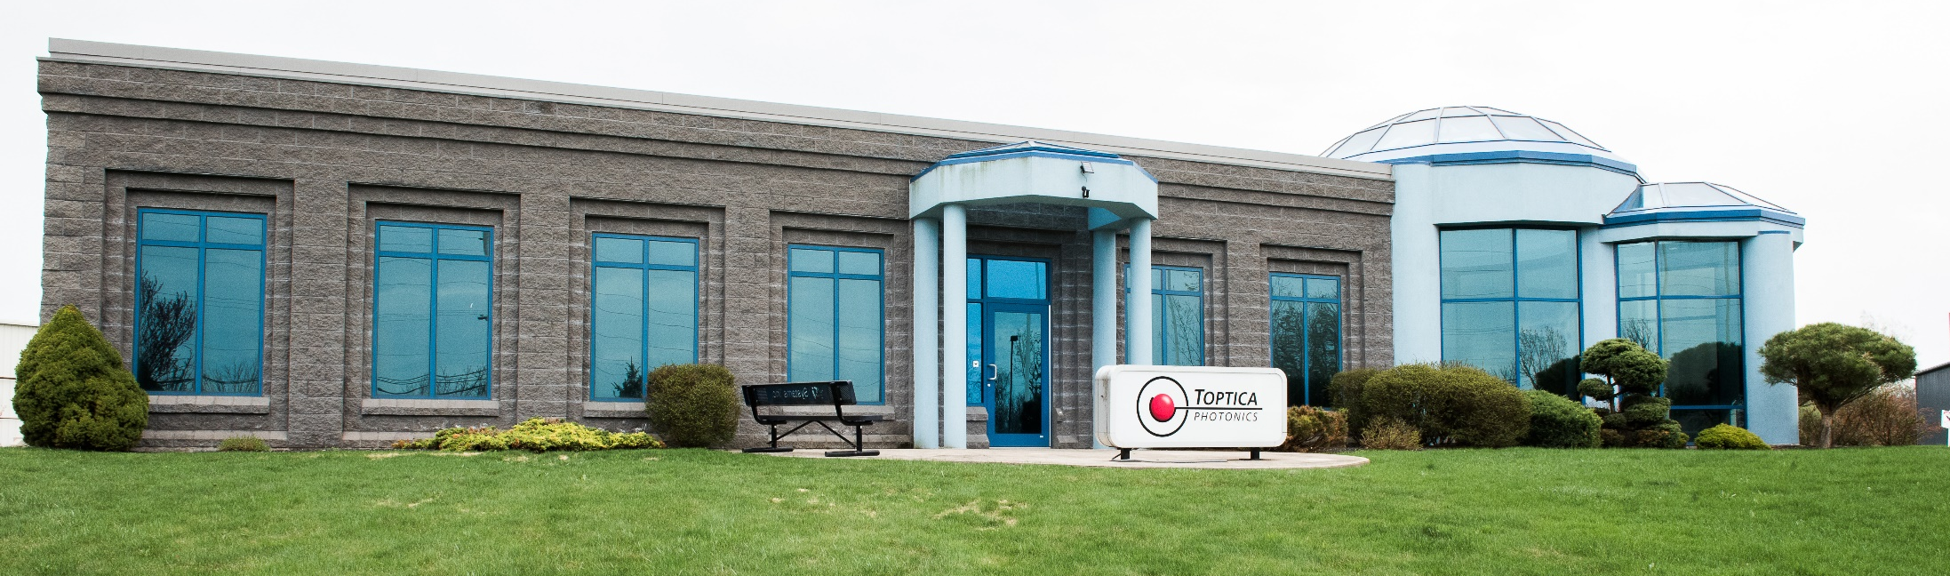
TOPTICA Group: Key Figures
Key Figures
Technology
Employees 380
Revenues $90M
Founded 1998
Diode Laser Systems Ultrafast ps/fs Fiber Lasers Terahertz Generation High Power Laser Diodes | 190 – 4000 nm 390 – 15000 nm 0.1 – 6 THz 630 – 1120 nm (TOPTICA eagleyard)
Notes:
TOPTICA was founded in 1998 as a spin off from a quantum optics group - and since then we’ve been constantly growing and meeting the emerging applications in quantum with our laser systems. We’ve expanded to locations across the globe, including the North American location that I oversee in New York.

Slide 3
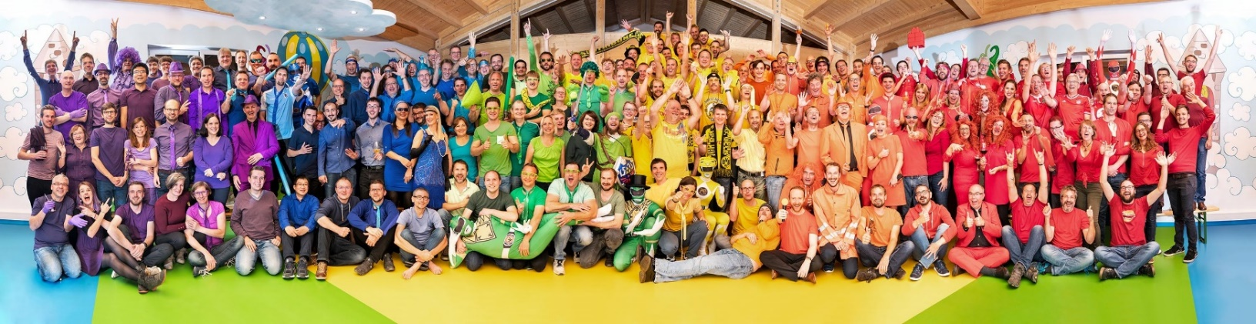
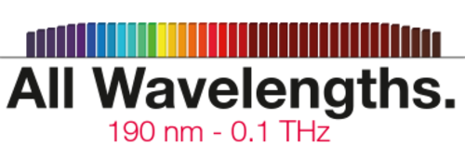
TOPTICA Photonics: Broadest Wavelength Coverage
Notes:
Worldwide, TOPTICA is a team of about 380 employees. We take pride in offering the broadest wavelength coverage of any laser company on the planet.

Slide 4
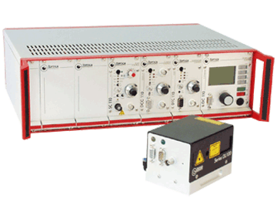
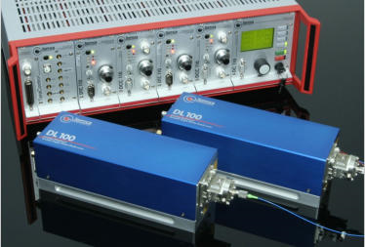
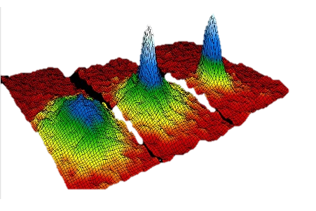
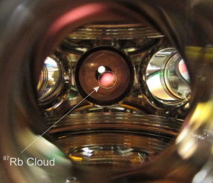
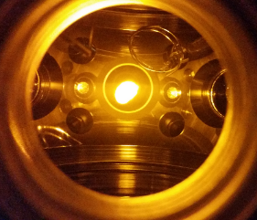
Innovating since 1998: DL 100
Na Cloud
Bose-Einstein Condensate
DL 100 The quantum workhorse!
Notes:
We officially started our product development in 1998 with our DL 100 ECDL, and this laser was the workhorse of the early atomic physics experiments with cold atoms and ultracold degenerate quantum gasses – and perhaps a majority of old school AMO physicists have come across these lasers at some point in their research carrier.

Slide 5
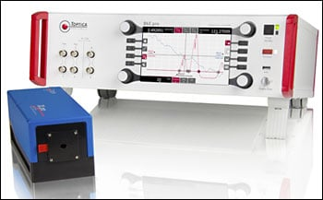
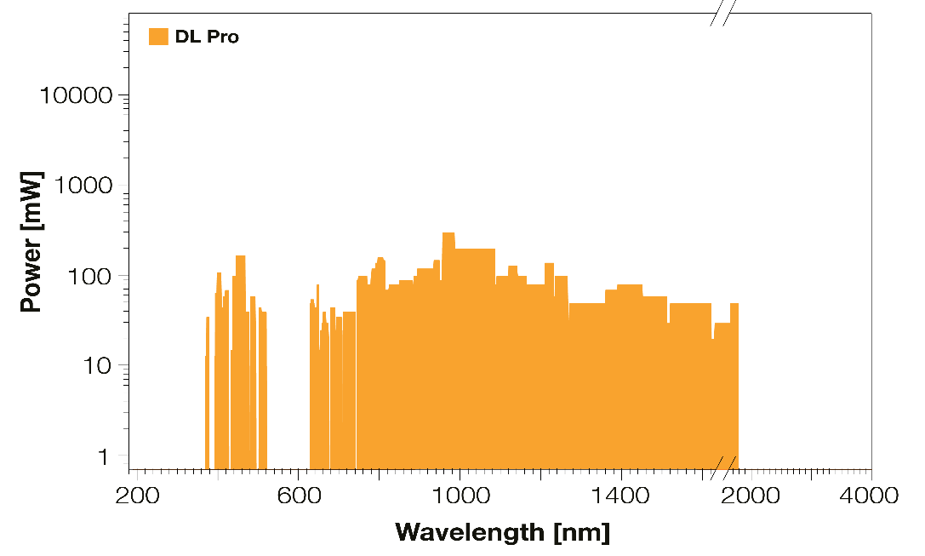
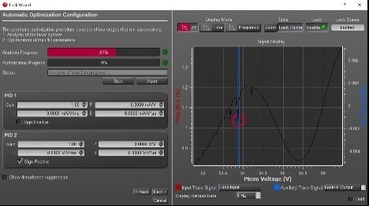
Innovating since 1998: DL Pro
DL pro takes over!
Notes:
But soon after, the community got pulled into more sophisticated quantum research, and they needed more advanced ECDLs to address this. So we used our experience in this field, to roll this again to a whole new generation of ECDLs called DL pro with an innovative cavity design and a fully automated digital locking mechanism.

Slide 6
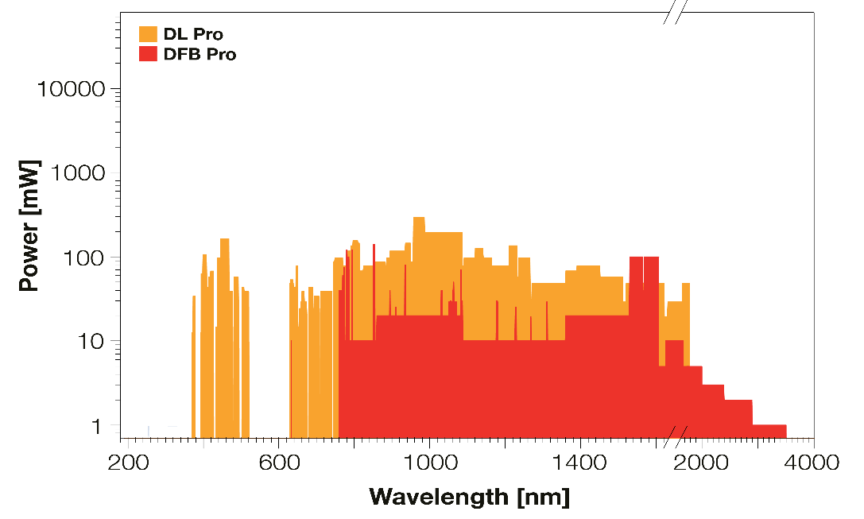

Innovating since 1998: DFB Pro
DFB pro compact & robust!
DL pro
Notes:
We also offered our DFB pro lasers to address the needs for compact and robust frequency-stabilized lasers for harsh environments

Slide 7
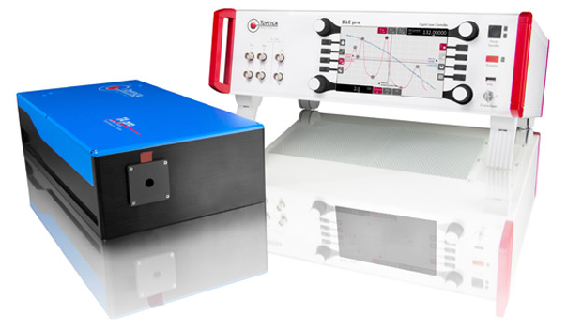
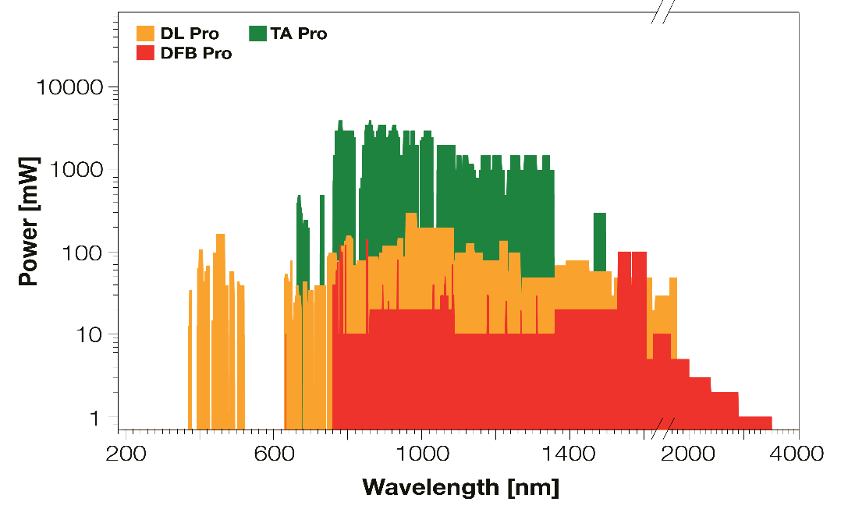
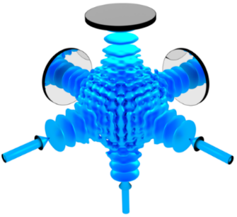

Innovating since 1998: TA pro
TA pro
Power cranked up!
DFB pro
DL pro
Notes:
and when the high power ECDLs were needed, for example for optical lattices, we stepped up with our tapered amplifier TA pro lasers that have been nicely meeting these applications ever since.

Slide 8
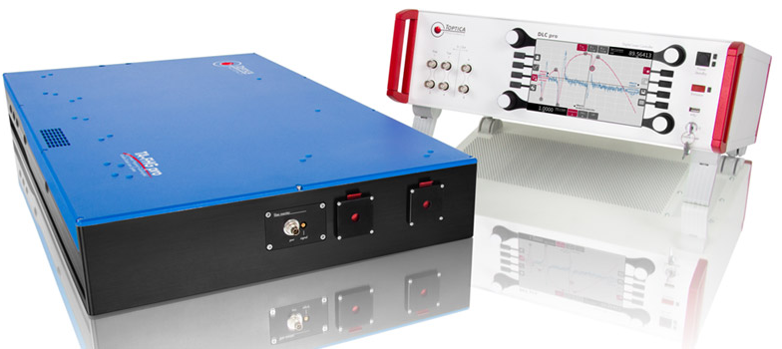
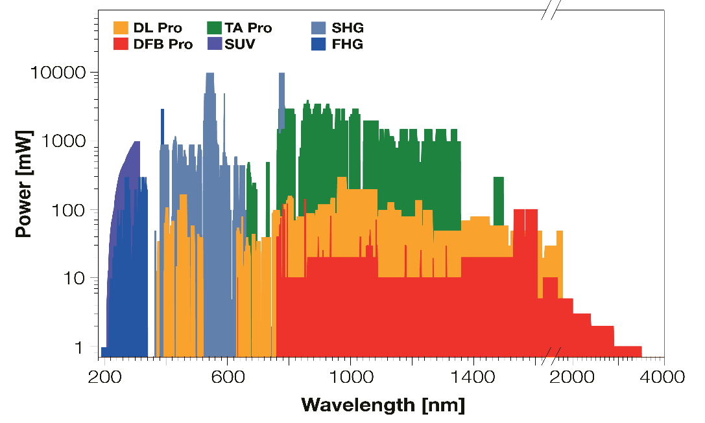
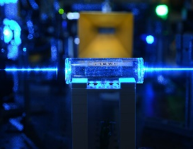
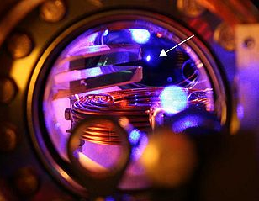
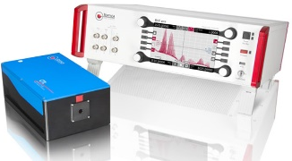
Innovating since 1998: TA SHG/FHG pro
Rb Rydberg sensing
TA SHG/FHG pro
New species/transitions
New applications!
TA pro
DFB pro
DL pro
Notes:
We’ve also been catching up with the new atomic species, or new lines for example for Rydberg transitions, and we offer our 2nd and 4th harmonic generation lasers with extended wavelength ranges all the way down to 190 nm.

Slide 9
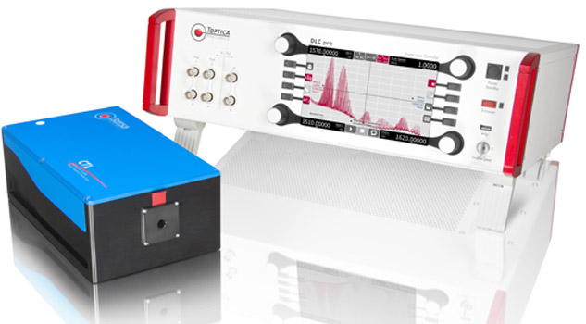
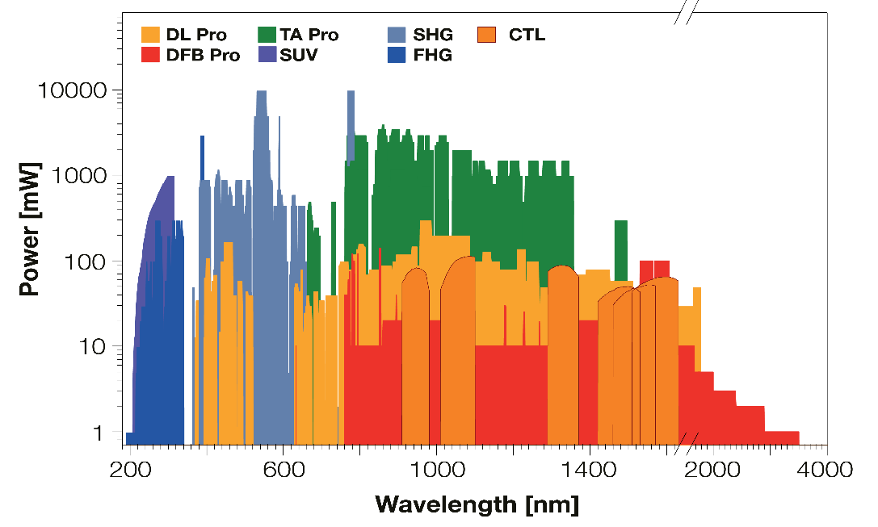
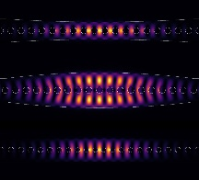

Innovating since 1998: CTL
CTL
Wide tunability
Microresonators
Photonic crystals
Quantum dots
TA SHG/FHG/SUV pro
TA pro
DFB pro
DL pro
Notes:
But as we all know, quantum is not limited to the atoms. Condensed matter physicists have also been pushing quantum boundaries with micro-resonators, photonic crystals, quantum dots, etc - and we need widely tunable lasers to explore and utilized the transitions of these systems. So we have developed mode-hop-free lasers with tunabilities of 10s of nanometers to address this very need in a most reliable fashion.

Slide 10
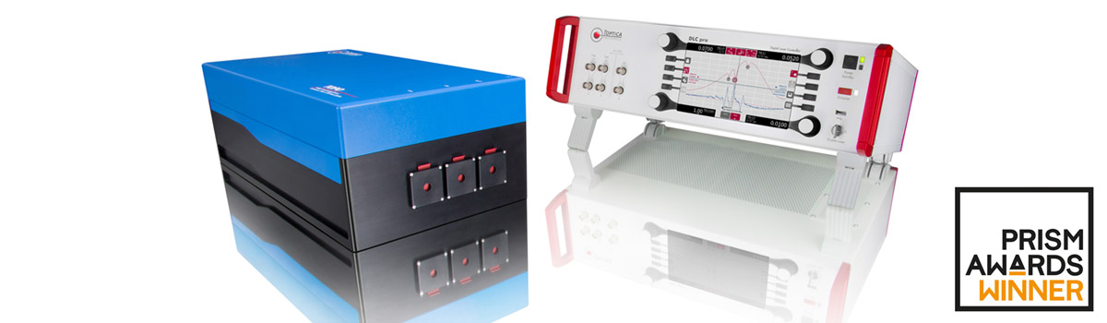
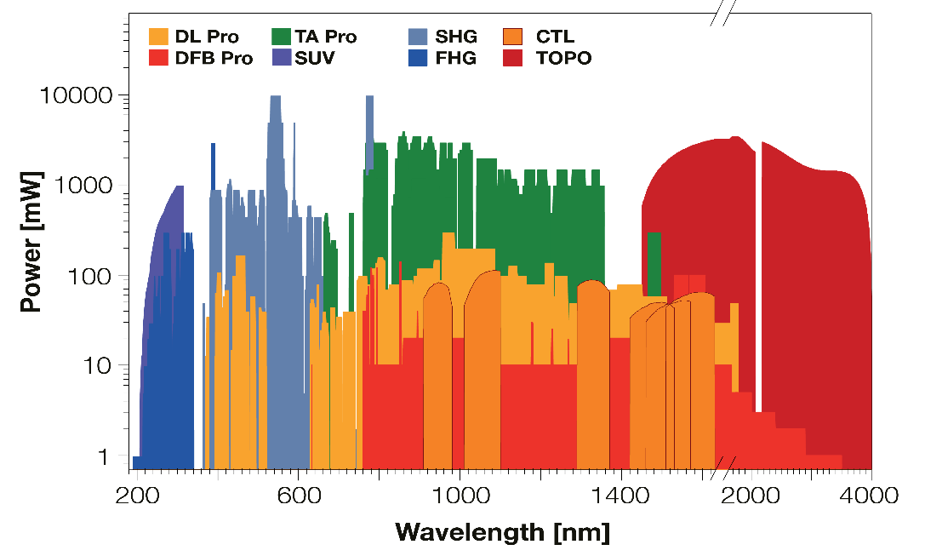


Innovating since 1998: TOPO
TOPO Mid-infrared Spectroscopy
CTL
TA SHG/FHG/SUV pro
TA pro
DFB pro
DL pro
Notes:
Then when it comes to the molecular species, we offer the most widely tunable OPO laser in the market, for example for doing mid-IR molecular spectroscopy or ultracold molecular quantum chemistry, which require narrow linewidth lasers with tunability across the mid-IR range.

Slide 11
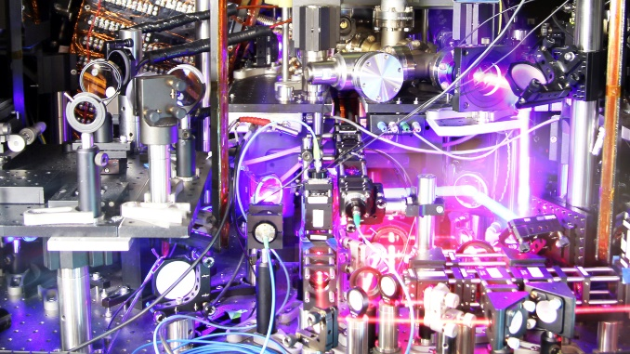
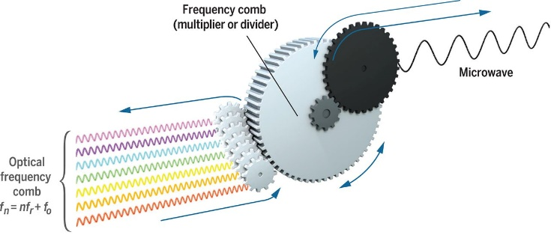
Frequency Combs
02
06
01
05
03
Strontium optical clock at JILA, UC Boulder (The Ye Group)
04
01. DFC CORE+ Offset-free frequency comb @ 1560 nm
02. DFC EXT Comb extensions between 420 - 2000 nm
03. DFC MD Monochromatic detector
04. DFC BC Beam combiner
05. FALC Locking electronics
06. DLC DL pro Or any TOPTICA Laser
Notes:
COMBs:
We push our innovations even further with our offset-free frequency combs and their wavelength extension modules. These systems are the backbone of the applications like phase-locking of multiple lasers in atomic clocks, or atom and ion-based quantum computers and networks. And we also offer a variety of our linewidth narrowing and phase locking electronics to make all these components work in conjunction.

Slide 12
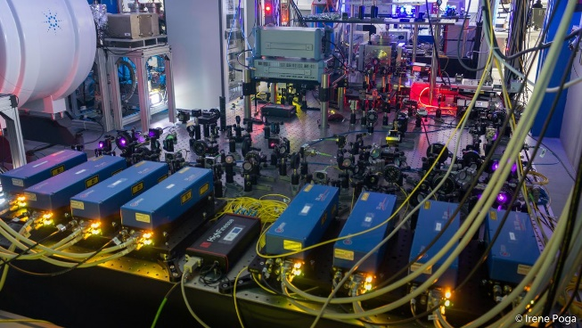
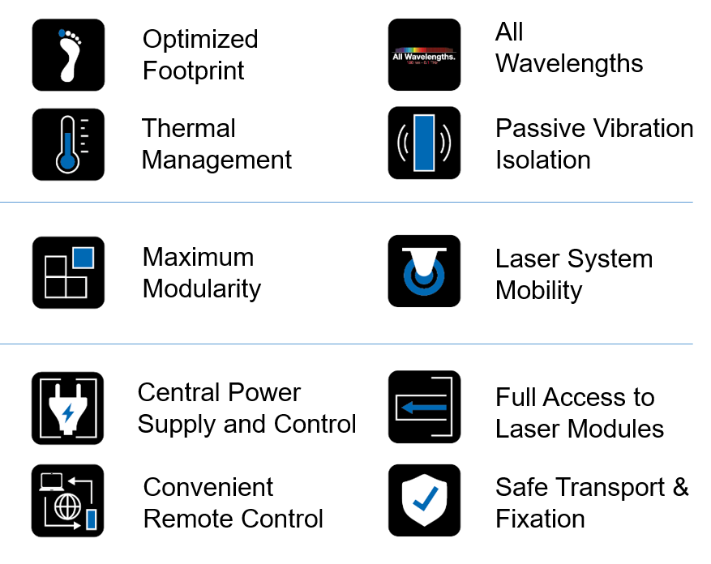
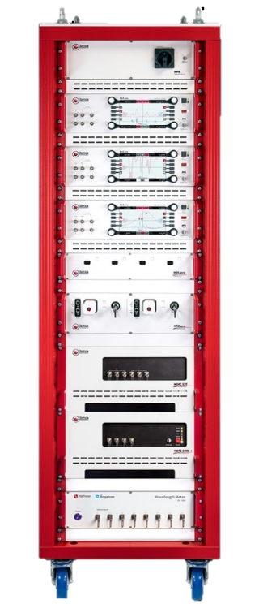
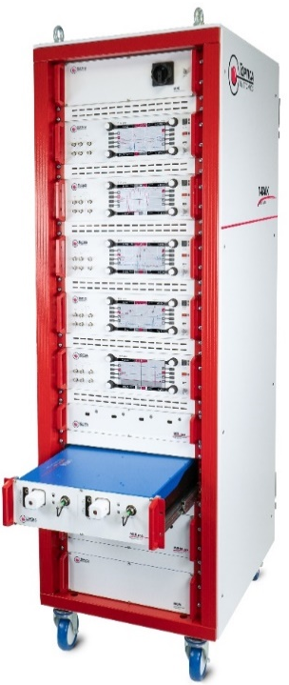
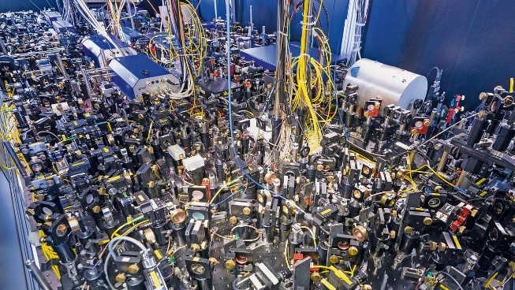
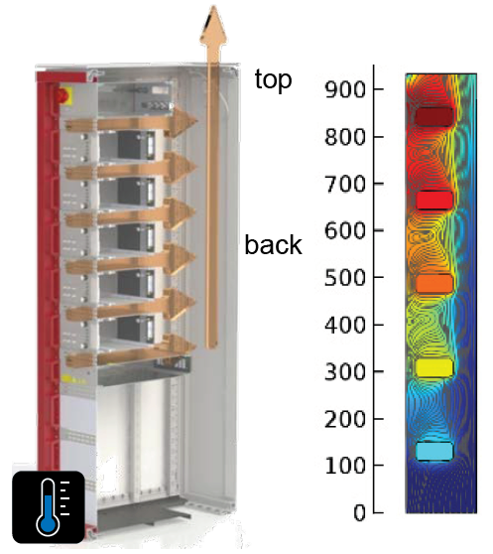
T-RACK
Irene Poga / Faculty of Science, Universidad de Granada
Max-Planck-Institut für Quantenoptik (MPQ)
Notes:
T-RACK:
Finally, we understand the need for the compact and integrated laser systems when it comes to these types of huge and busy optical setups. So we’ve overcome this significant challenge with our T-RACK systems – which are the fully integrated solutions for these types of demanding quantum experiments. And these systems are modular, so we can customize the integration of all the lasers and electronics and even the tabletop optics in standard 19” rack modules.
We’ve engineered these systems in terms of noise cancellation and passive cooling to make them work as good as our tabletop systems, and of course with much smaller footprints– and that saves a lot of space on the optical table, or even eliminates the need for a table in field deployable cases.

Slide 13
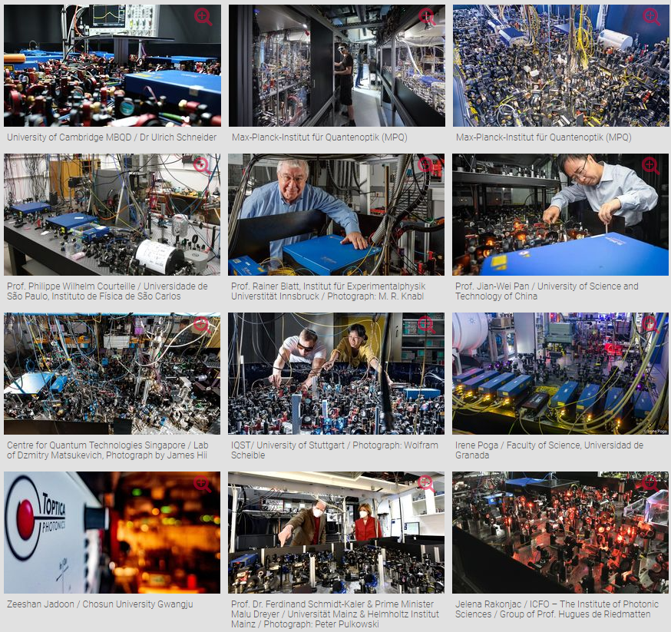
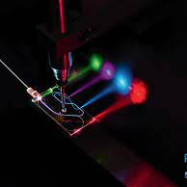
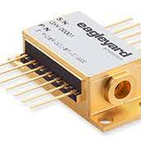
We continue to be an enabler for quantum

Slide 14




We enable quantum!
Ca⁺
Yb⁺
Sr
Rb
Li
K
Nd³⁺
Sr
Yb
Yb⁺
Sr⁺
Rb
Hg
Ca⁺
Rb
Tm³⁺
Ca⁺
K
Sr
Yb
Yb⁺
Cs
Yb⁺
Ca
Yb
Ba⁺
Cs
Hg⁺
Al⁺
Mg⁺
Hg
Pr³⁺
Li
Xe
Eu³⁺
Sr⁺
Cs
Q dots
He
Er³⁺
H
Cd
Q dots
Q dots
Th³⁺
In⁺
Na
Color centers
Color centers
Color centers
Quantum Computing
Quantum Sensing
Quantum Communication
Quantum Metrology
Notes:
So to wrap up, we’ve been developing high-end lasers for quantum applications for more than 20 years - and we see ourselves at the frontiers of quantum, from fundamental research to the real-world applications. We have enabled quantum industrialization with hundreds of product developments and the partnerships that we have established over the years.
So we can leverage this unique experience and network to work with other quantum industries in different ways, from giving strategic advice to mature their technology, to collaborating on system integration and testing, to commercializing their laser-related quantum products.

Slide 15

Contact
Mark Tolbert
mark.tolbert@toptica-usa.com
TOPTICA Photonics Inc
Notes:
If you have any questions or would like to further discuss TOPTICA or any of our products, please reach out to me at the email address displayed on the screen. Thank you for your time.

