Slide 1
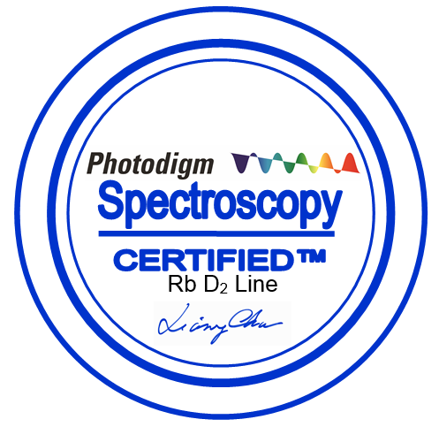
Spectroscopy Certified™ DBR Lasers
Scalable Semiconductors for Quantum
Quantum Marketplace Webinar
May 2021

Slide 2
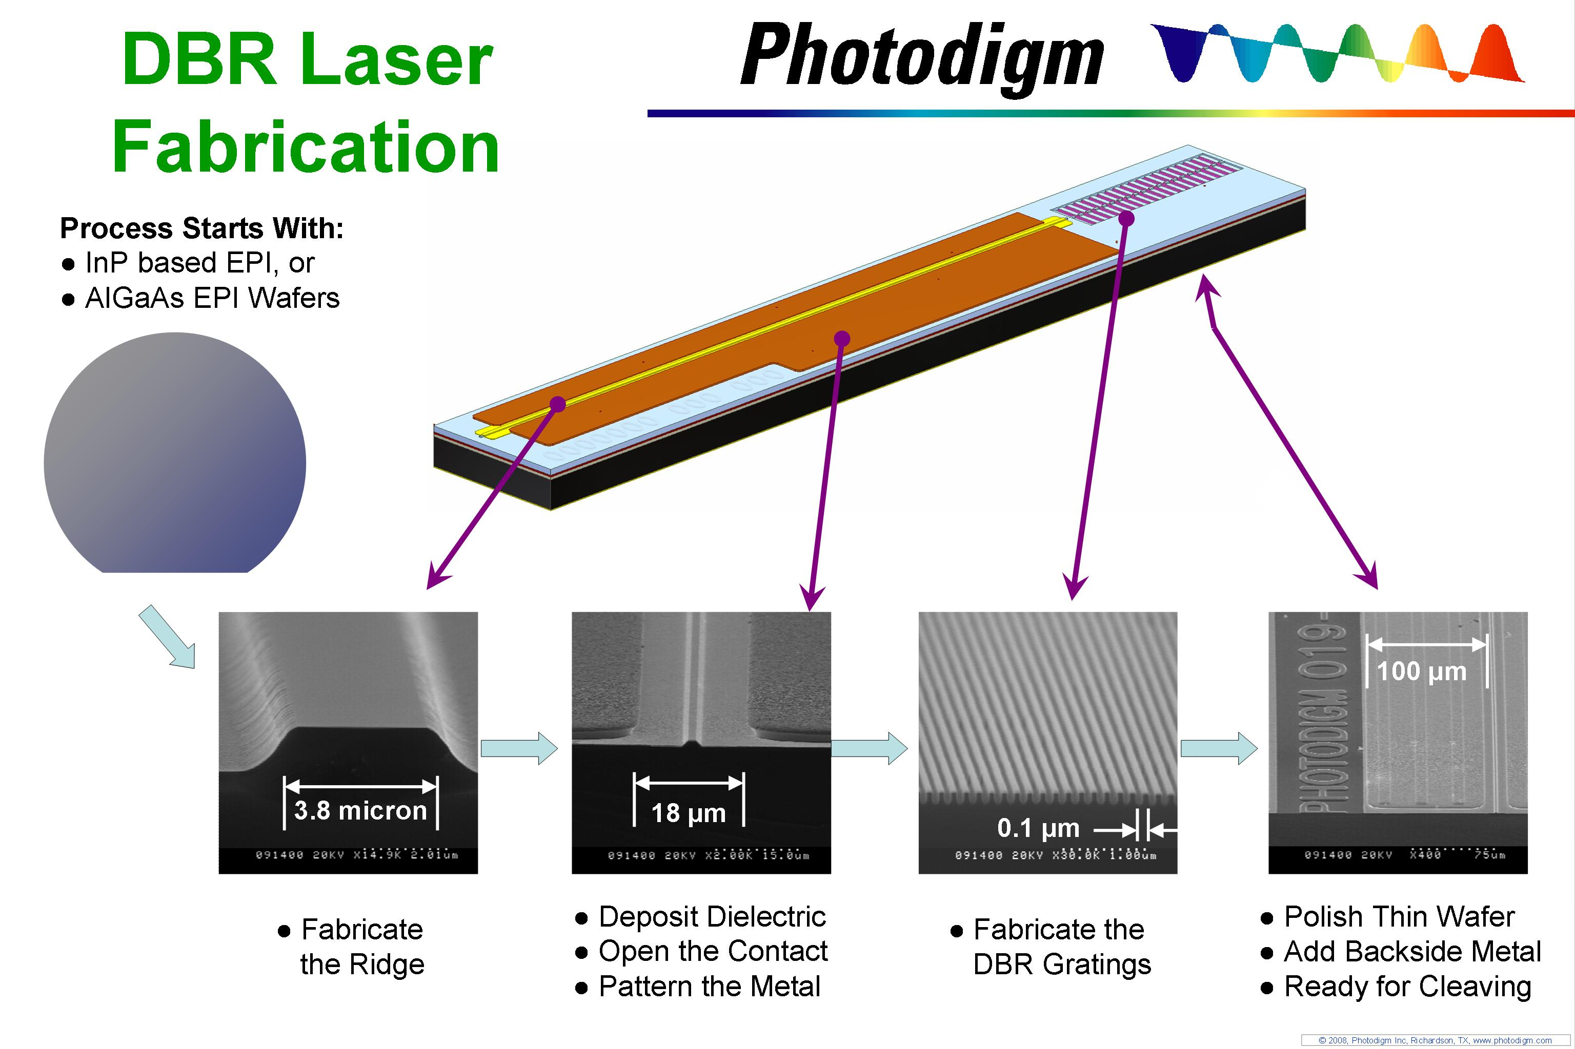
We start with the gain medium…
  Vertically integrated
      In house wafer fab
      Chip to package solution
Designed for Quantum
      Single frequency
      Tunable
      Monolithic
      Integrated
    Used by researchers today
    Scalable for OEMs tomorrow
…and enable the OEM Product

Slide 3
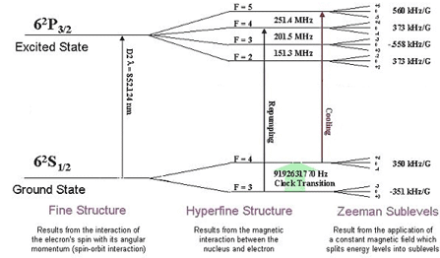
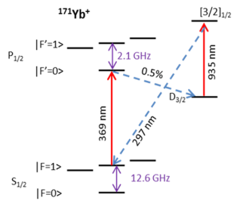
Photodigm DBR lasers: a Platform Technology
Clocks, Magnetometers, Gravimeters, Communications, Computers
Direct 369
Yb⁺
(under development)
Ca, Ba, Sr wavelengths by frequency conversion
(fundamental wavelengths available)
Existing DBR Products between 739 ad 1100 nm
770
780 Rb
852 Cs
461
739
767
770
795
895
920
1083
397
404
436
1083
Tunable, single frequency Photodigm Spectroscopy Certified DBR lasers are available at key wavelengths
Yb⁺
Cs
Rb

Slide 4
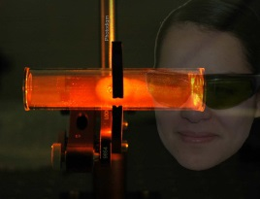
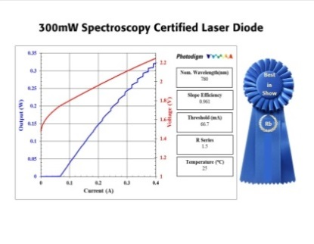
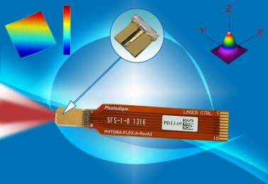
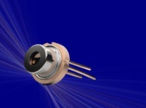

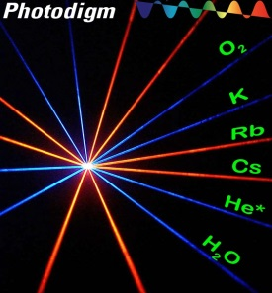
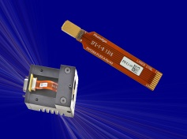
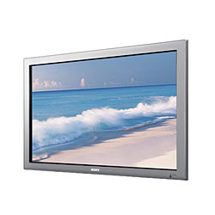
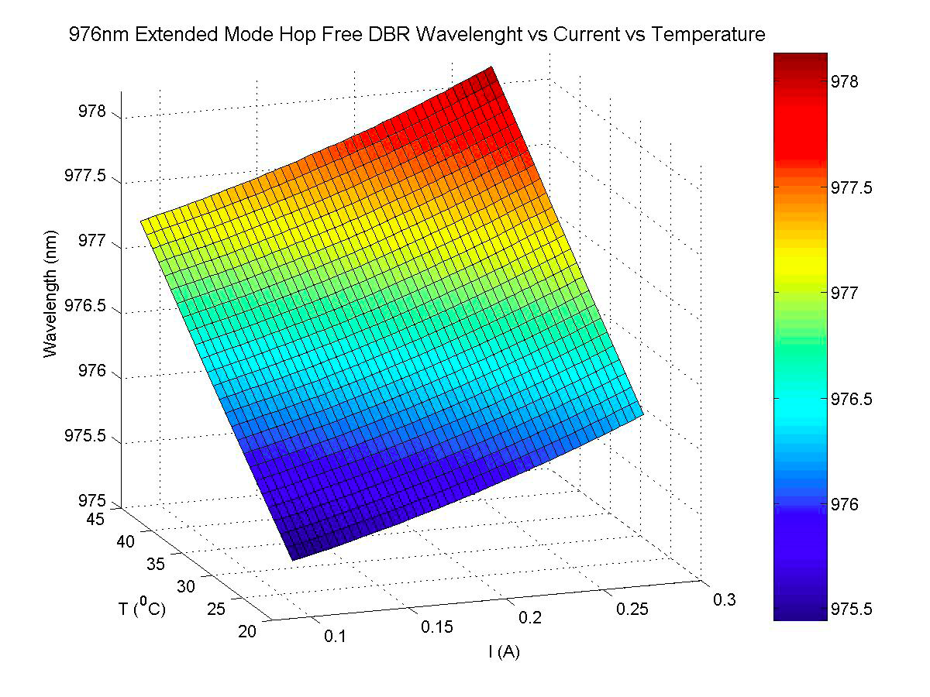
Continuous Market Driven Product Development
Product Supporting
Quantum
Information
Laser Diodes for Atom Optics:
Rb, Cs and He*
780, 852 and 1083nm
SAF gain chips
for
OEM package
PreciseMode­™ DBR Laser
Delivering performance of a
bulky research laser in a
compact OEM package
Augmented Reality
Highest Powers
Rb and Cs DBRs:
180mW - 780nm
280 mW - 852nm
Biomedical Diagnostic
2007
2007
2009
2011
2013
2015
2017
2019
2021
Today
Full line for Atom Optics
D1 Lines:
767, 770, 795, 895 nm
Extended Mode Hop
Free DBRs (EMHF)
Spectroscopy
Applications:
760, 785, 808, 828nm
High Temp DBRs up to 80°C
Laser Diodes for
Frequency Doubling
1064, 920, and 976nm

Slide 5
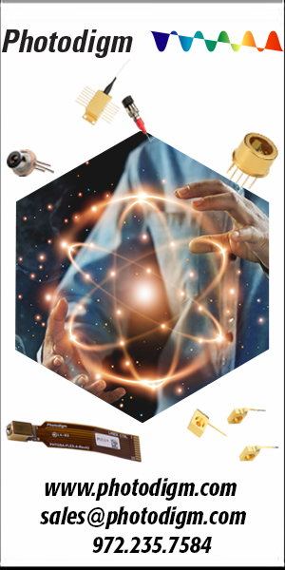
Support Strategy
– to be wherever our customer is
The Web
    Photodigm.com
Trade Shows
    Photonics West, CLEO, Laser Expo (Japan), Laser World of Photonics
Sales & Applications Team
    Bob Davis, Vice President of Sales
    Esther Moreno, Inside Sales Manager, End User Sales
    Annie Xiang, Director of Products
Distributors in all key international markets
Quantum Economic Development Consortium

