Slide 1
Laser Technology & Capabilities for Quantum
Steven Estrella
Quantum Technology & Applications Technical Leader
© 2021 Freedom Photonics LLC

Slide 2
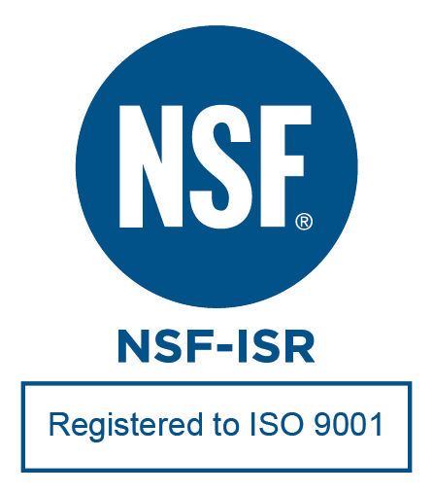
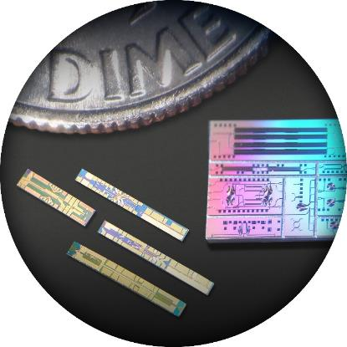
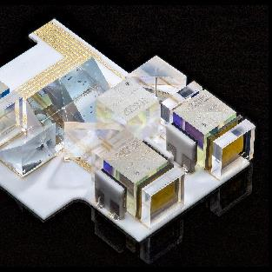
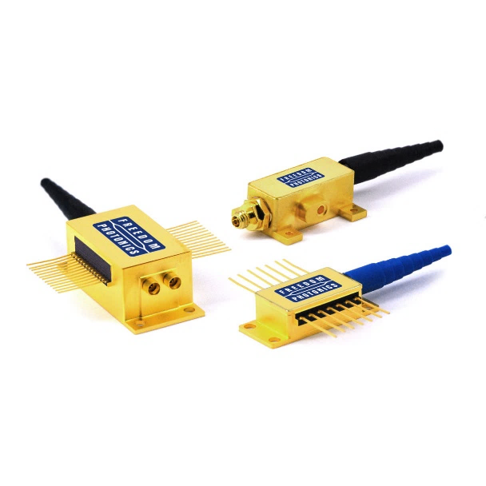
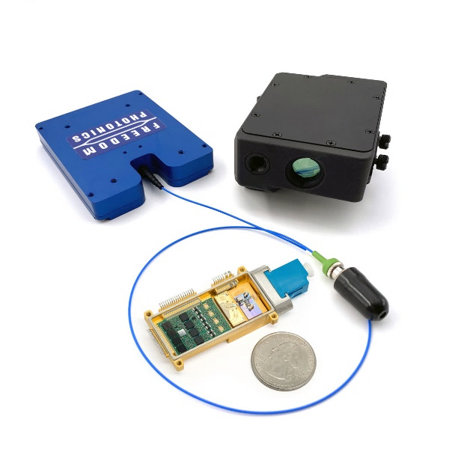
Freedom Photonics Overview
Manufacturer of unique and innovative photonic components, modules and subsystems
From chip-to-subsystem
InP, GaAs, SiPh and hybrid solutions
Quantum Markets and Applications
Quantum Sensing
Quantum Communication
Quantum Networking

Slide 3
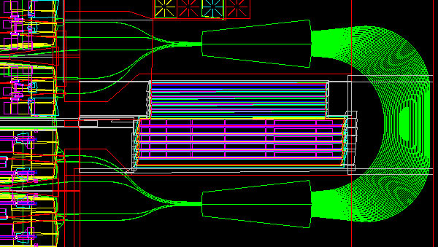
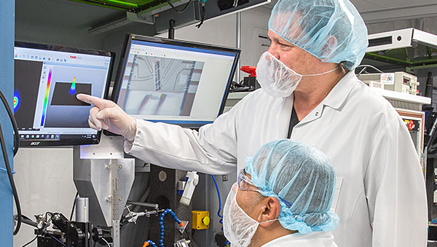
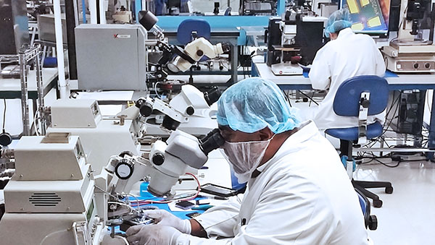
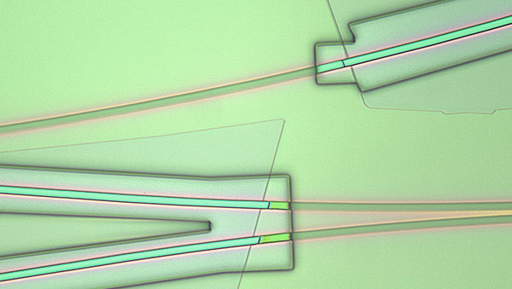
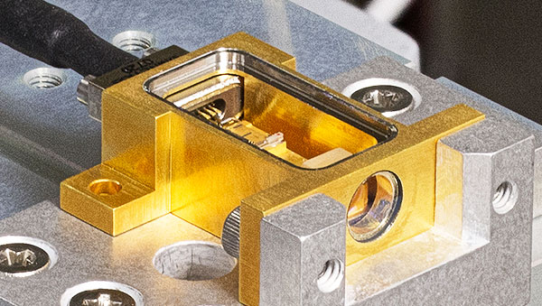
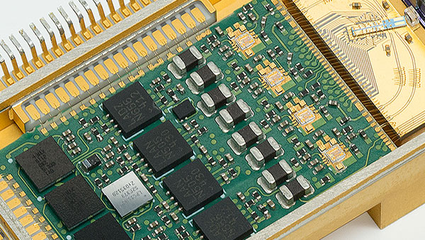
Freedom Photonics is Vertically Integrated
Design
Test
Manufacturing
Fabrication
Packaging
Subsystems

Slide 4
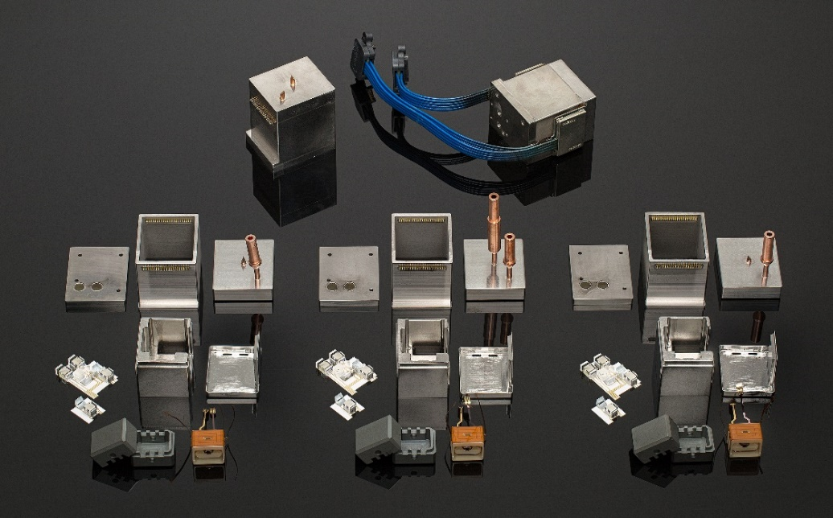
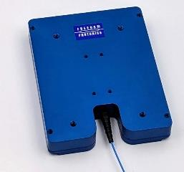
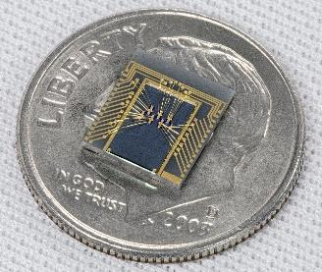
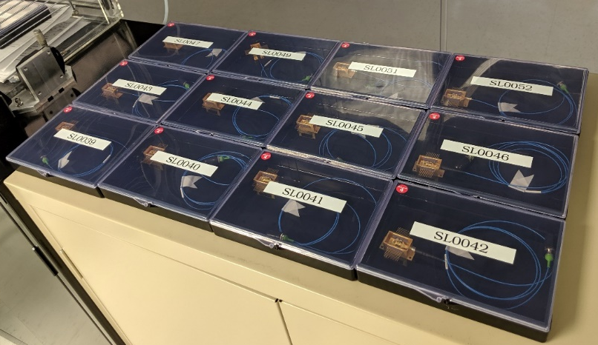
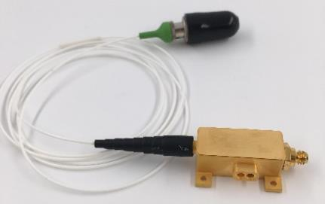
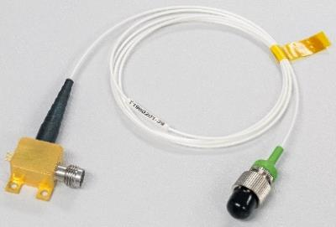
Freedom Photonics Product Offerings
Fast tunable lasers and high-power lasers
High-performance photodetectors
Private label products
Notes:
Tunable Lasers from 1250nm to 1750nm
High power DFB lasers at 1280nm and 1550nm, >400mW
Single spatial mode, >1W
PDs with up to 100 mA photocurrent, up to 115GHz, powers up to 27 dBm
Custom laser solutions
Custom PIC solutions
Advanced micro-optic solutions

Slide 5
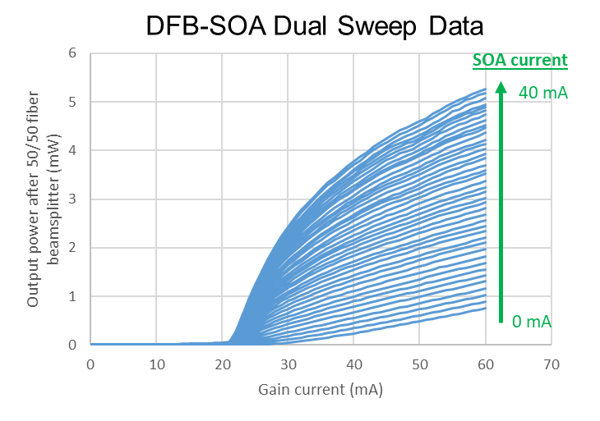
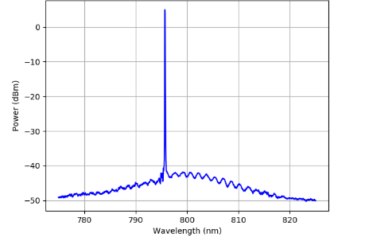
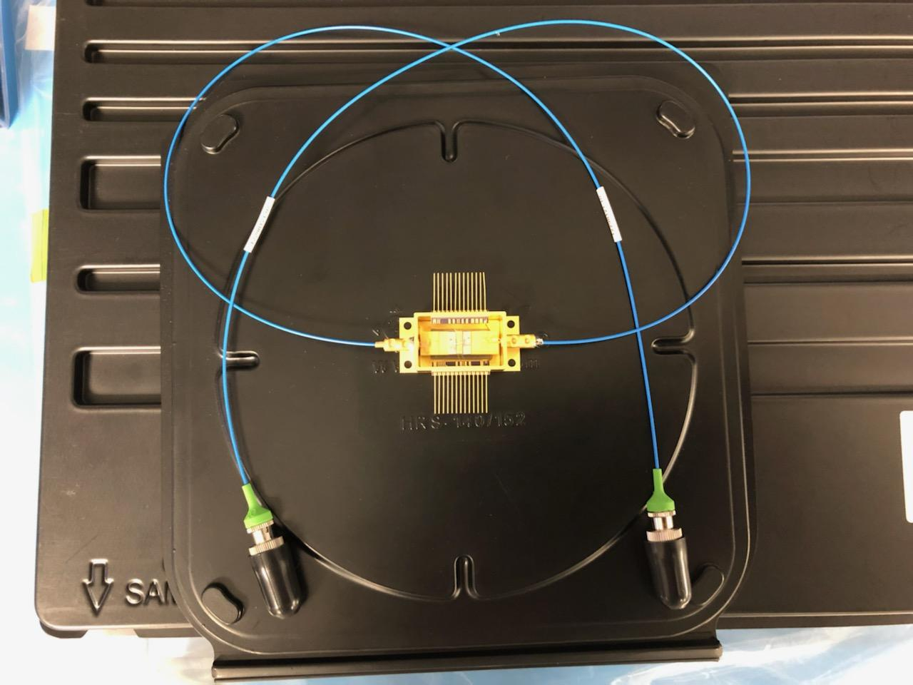
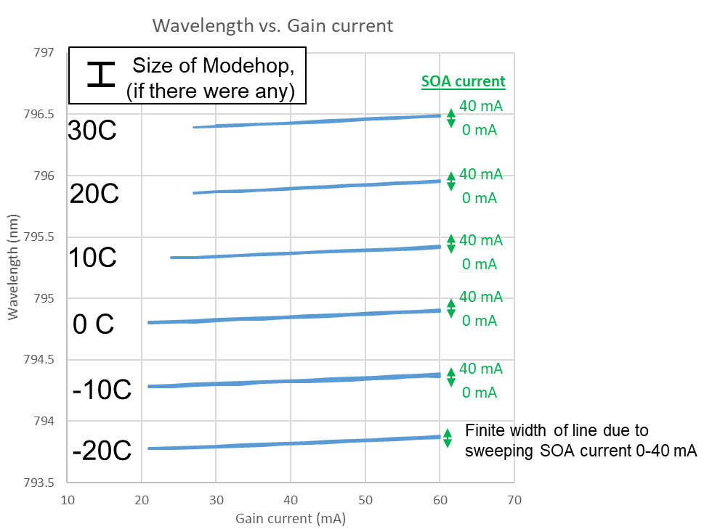
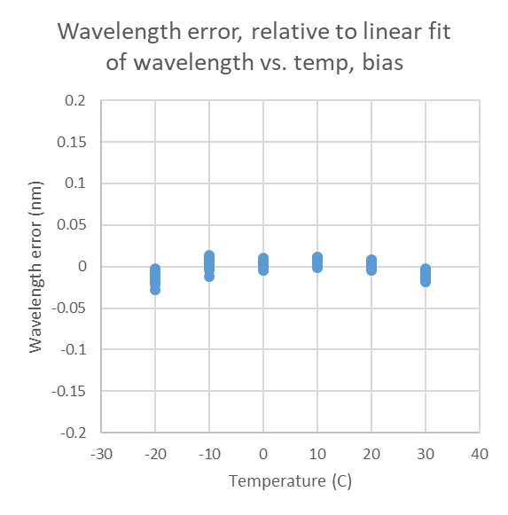
Tunable 7xx nm & 8xx nm Lasers for Atomic Sensing
Characteristic Spectra
Modehops, if they existed would be at ~ +/- 0.15 nm
Mode-Hop
Free

Slide 6
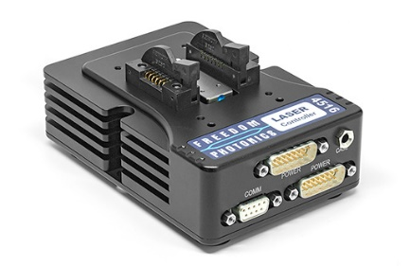
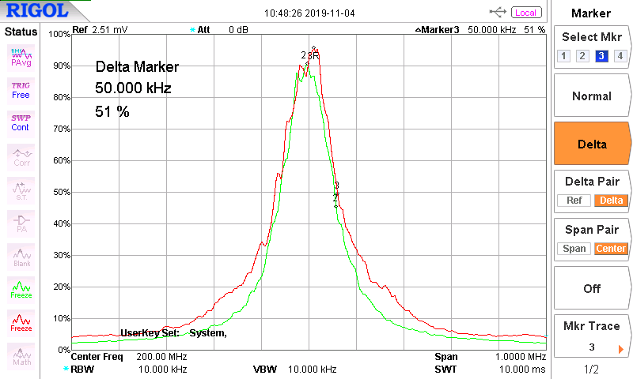
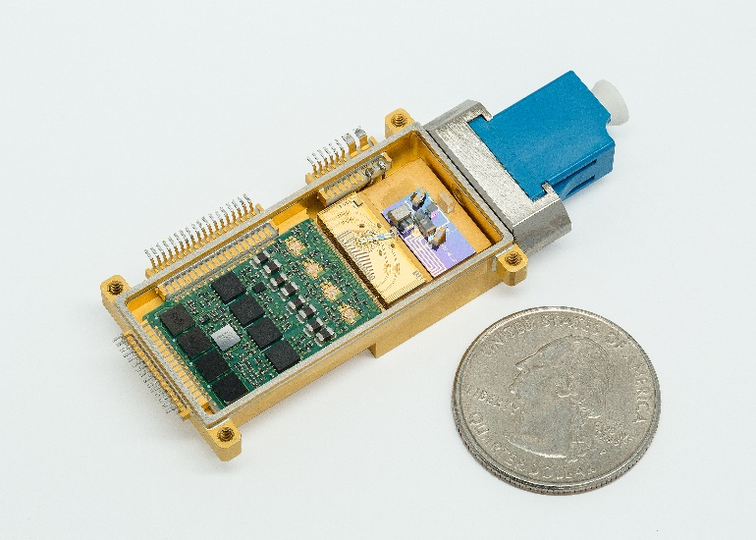
Laser Control Electronics
Low-noise laser drivers, comparable to battery as a source
High wavelength stability with active wavelength locking

Slide 7
Thank You!
Steven Estrella
Quantum Technology & Applications Technical Leader
Freedom Photonics, 41 Aero Camino, Santa Barbara, CA 93117
info@freedomphotonics.com; 1-805-967-4900
freedomphotonics.com

