Slide 1
Lasers & Photonics Tools for Quantum Systems
Title Here
Scott Davis, Co-founder and CEO of Vescent Photonics Chair of the QED-C Enabling Technologies TAC
05/27/21

Slide 2
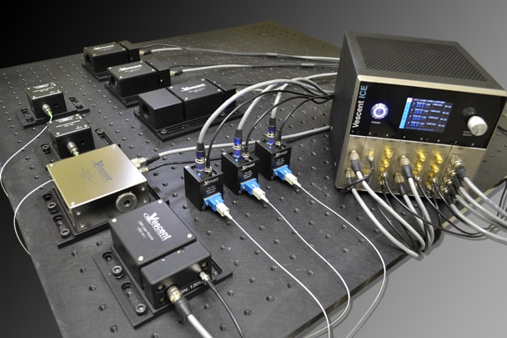
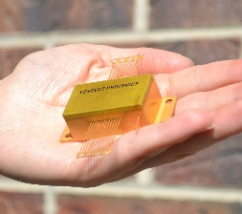
Quantum Marketplace
Products that enable Quantum Systems
Vescent Quantum Development Platform
(4 laser atom interferometer system)
Vescent Deployed Quantum
Quantum Research Platform
(Ketterle MIT)
2

Slide 3
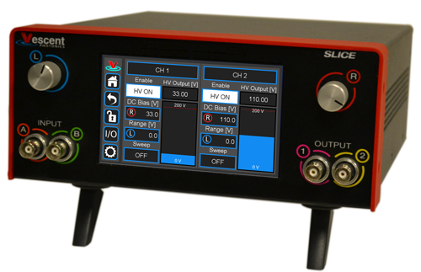
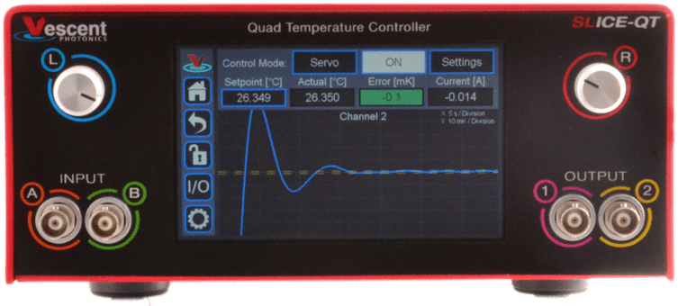
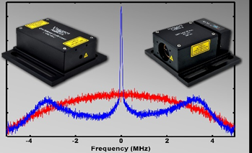
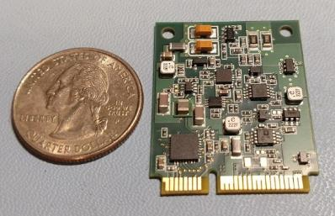
Support: Research, Development, & Deployed
Full Laser Solutions: Sources, Stabilization, Control
Multi-Laser Package, Control & Lock
JILA & JQI Inspired
It’s more than just the laser!
Quantum Lasers & Electro-Optics
Atomic references
Laser sources
Offset locking modules
Leading Quantum Control Electronics
Laser temp & current controllers
Fast & quiet PZT servos
PI²D laser & phase lock servos

Slide 4
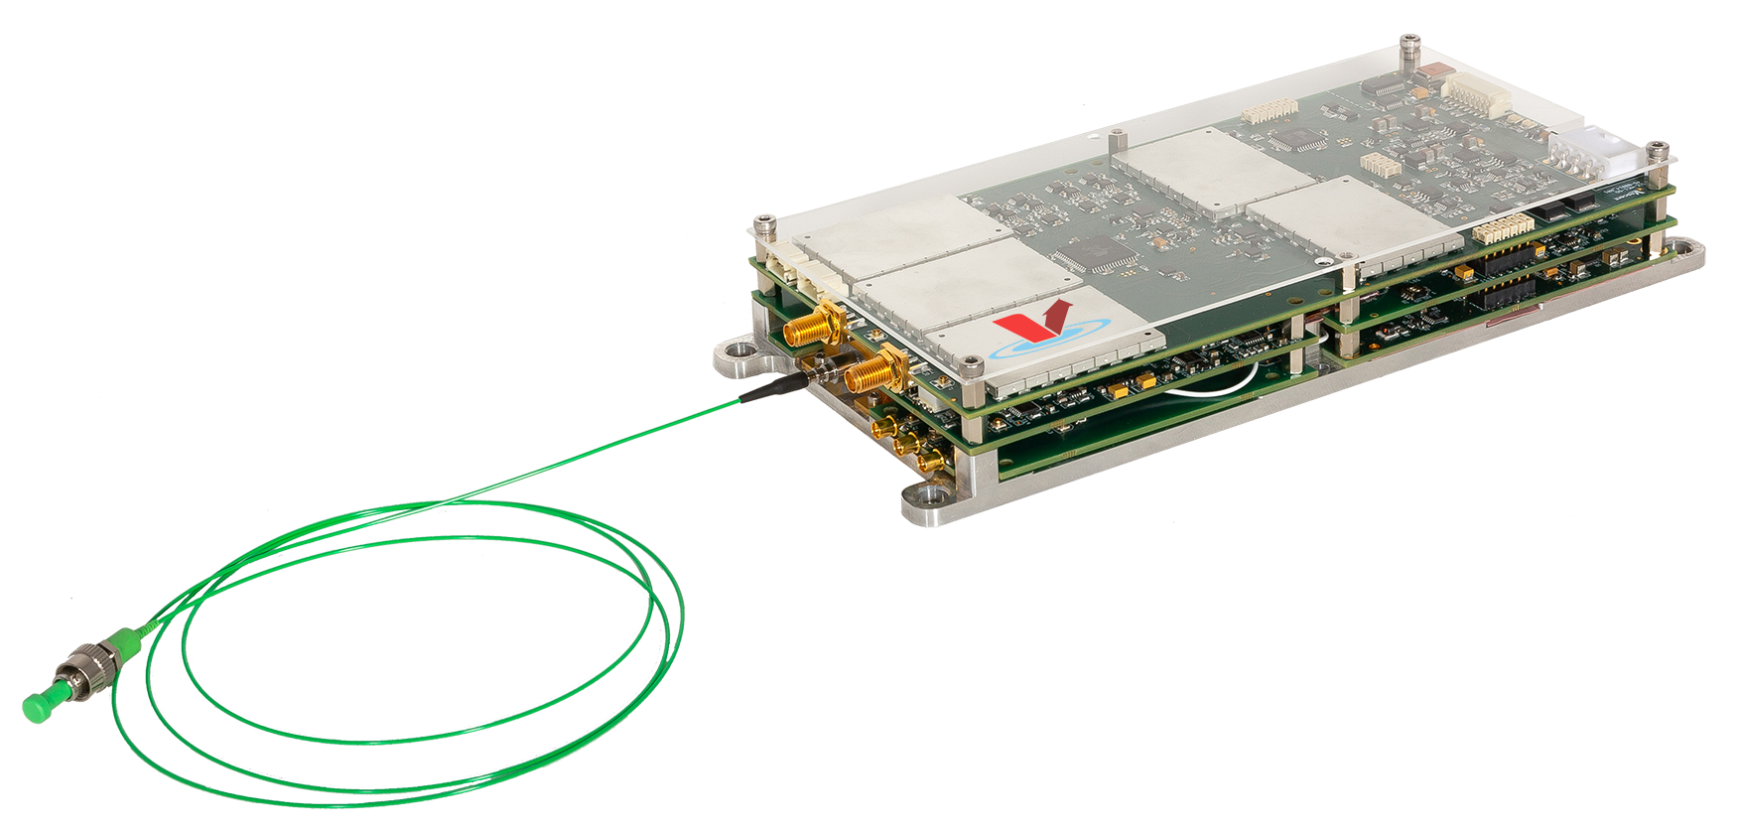
Quantum Marketplace
Field Deployed Quantum Laser Engines
Clocks
Computers
Sensors
Atom-Referenced
Frequency Agility
2 Lasers & Gas Reference
Beat-note Detector
4 Laser Drivers
6 Temperature Controllers
FM demodulation
PI²D High-Bandwidth Laser Servo
Offset Phase Lock Servo
<20 W Total Electrical Power
<0.5 L Volume
4

Slide 5
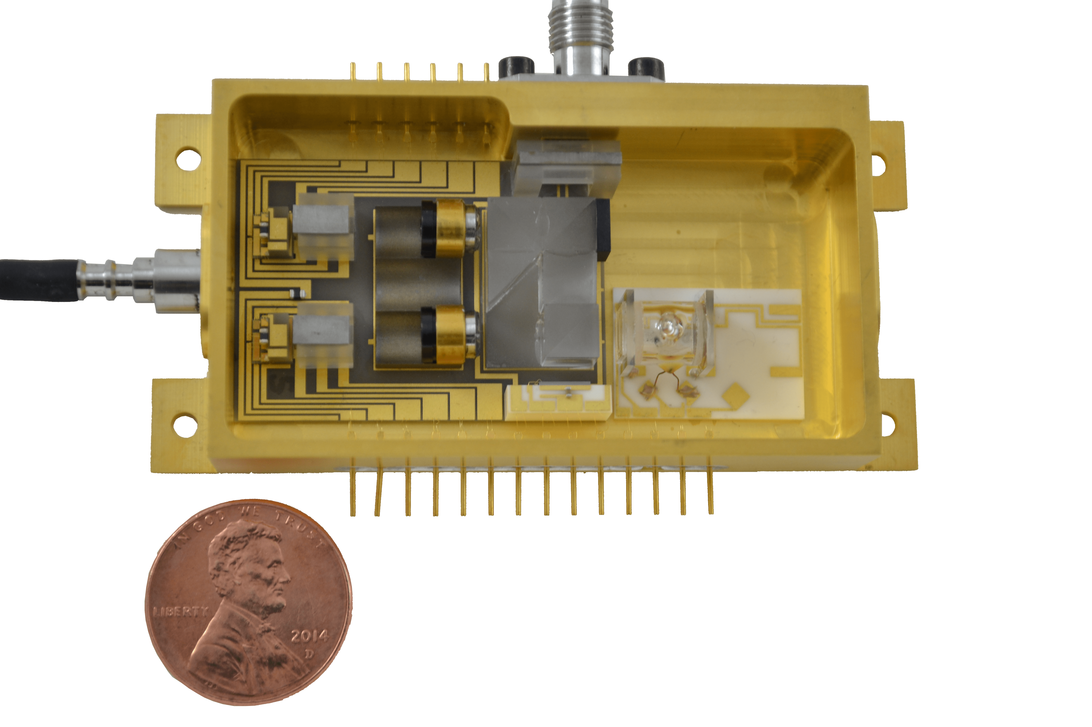
Quantum Marketplace
Optical Core of Quantum Laser Engines
Telecom style micro-optics assembly
Unit in a deployed clock running continuously for > 3 years.
5

Slide 6
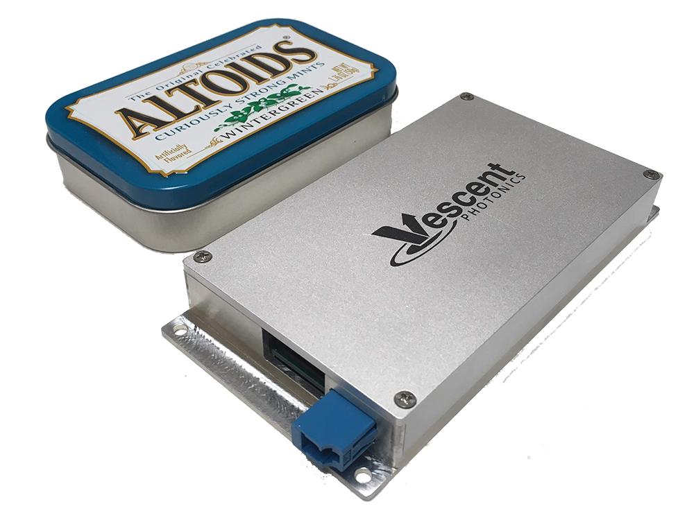
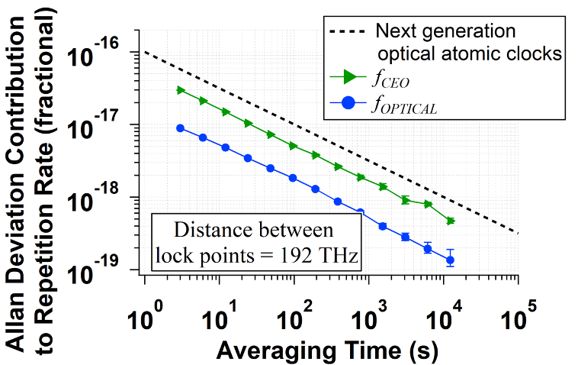
Quantum Marketplace
Turnkey Frequency Combs
Discipline multiple lasers
Optical clocks
Sensing
Field-Deployed Oscillators
(the heart of the comb)
Rad-hard versions
Fielded units in Oklahoma operated through the recent deep freeze
f_{opt}
f_{clock}
Spectrum
f_{rep}
f_{CEO}
Frequency

Slide 7
Feeding the Quantum Supply Chain
 | Timing | Computing | Sensing | Communicating
Commercializing Technologies:
Control
Electronics
Frequency Combs
& Femtosecond
Oscillators
Low SWaP
Deployable
Volume Scalable
Designed for Quantum
Micro-Optic
Modules
Watt Level CW Lasers from
NIR to NUV
Frequency Combs
Watt Level CW Lasers NIR-VIS-NUV
Coming Soon
Micro-Optic Laser & Optic Assemblies
Ultra-Narrow Linewidth Lasers
Coming Soon
7

Slide 8
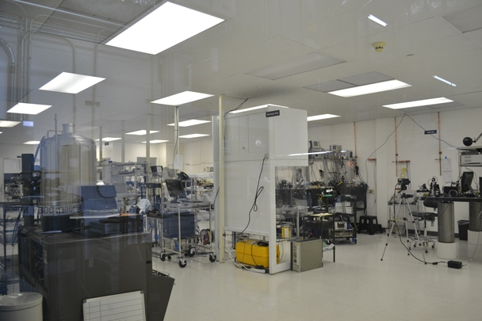
Quantum Marketplace
Production cleanroom in Golden CO
Let us manufacture the laser systems for you
we’ve been doing it for >15 years
8

Slide 9
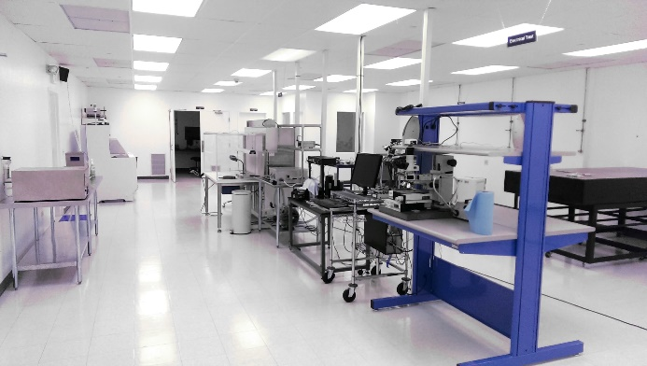
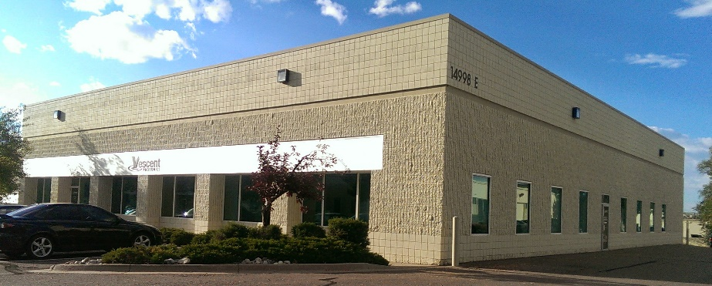
Quantum Marketplace
Contact us
www.vescent.com
sales@vescent.com
International Distributors:
https://vescent.com/us/contact/international-distributors.html
14998 W. 6th Ave., Suite 700 Golden, CO 80401
USA Tel: +1 (303) 296-6766 Fax: +1 (303) 296 6783
9

Slide 10
THANK YOU

