Slide 1
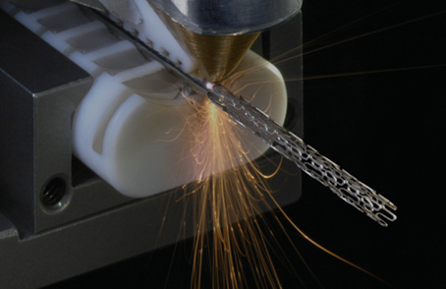
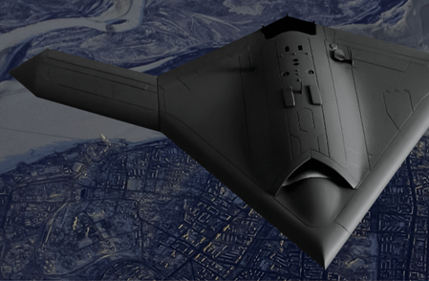
COHERENT
Precision Manufacturing
Bio-instrumentation
& Life Sciences
Annual Revenue (TTM)
$1,300M
Founded: 1966
Patents: >700
Employees
>5000
Optics
Lasers
Subsystems Processing Tools
Market Cap
$6,500M
Microelectronics
Aerospace & Defense

Slide 2
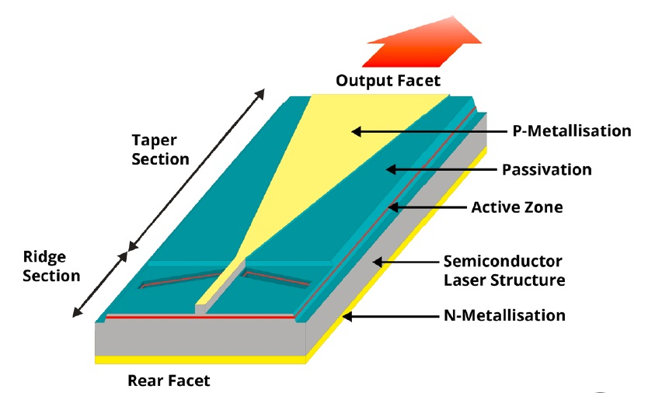
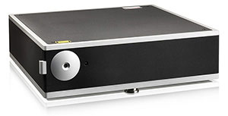
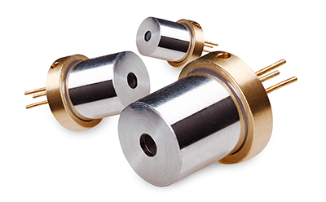
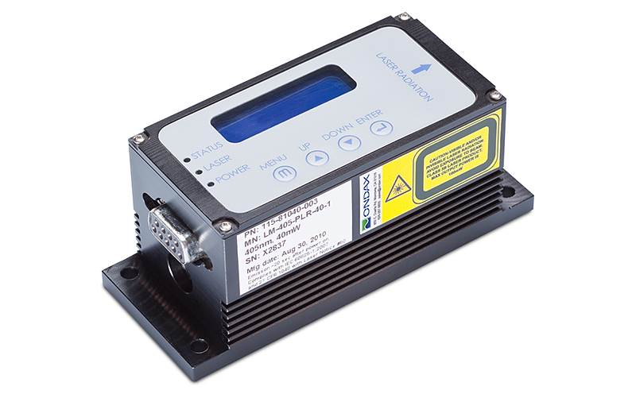
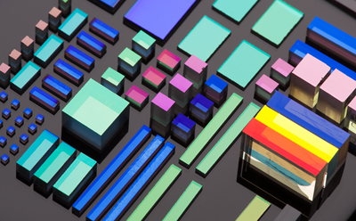
Coherent Products for the Quantum Community
Paladin
QCW
4 W @ 355 nm
Diodes/Tapered amplifiers
Mephisto
Diodes & VBGs
55W @ 1064nm
Monolithic ring
1kHz linewidth, low noise
CW
M² < 1.7
4 W @ 760-1060 nm
<1W @ 405nm & 780.25nm
Single Frequency
Ultra-narrow VBGs
Ion trapping
Atom cooling & trapping
BEC
Squeezed light
Neutrals cooling & trapping
Optical lattices
Quantum gas microscopy
Quantum simulators
Quantum Entanglement
Quantum Communications
Atomic clocks (Rb)

Slide 3
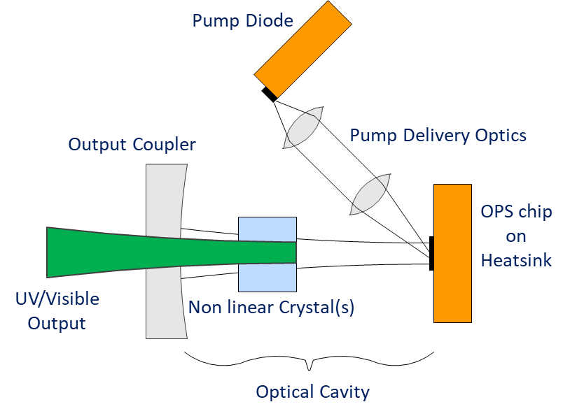
Optically Pumped Semiconductor Lasers (OPSLs)
Actual OPSL building blocks
Simplified OPSL schematic
External mirror
Pump
IR Lasing
Quantum Wells &
Pump Absorption
OPS chip
HR Mirror
Heat Sink
Intracavity wavelength stabilization
Intracavity doubling
Current modulation capable
Power scalability
chip designed to wavelength

Slide 4
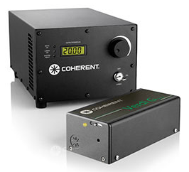
OPSL Benefits and Opportunities
High power capable @:
920-1180 nm (native)
460-590 nm (SHG)
2ω
ω
3ω
Wavelength coverage can be extended to 300-2,000 nm
3ω
2ω
ω
Verdi
well known for Ti:Sapphire pumping

Slide 5
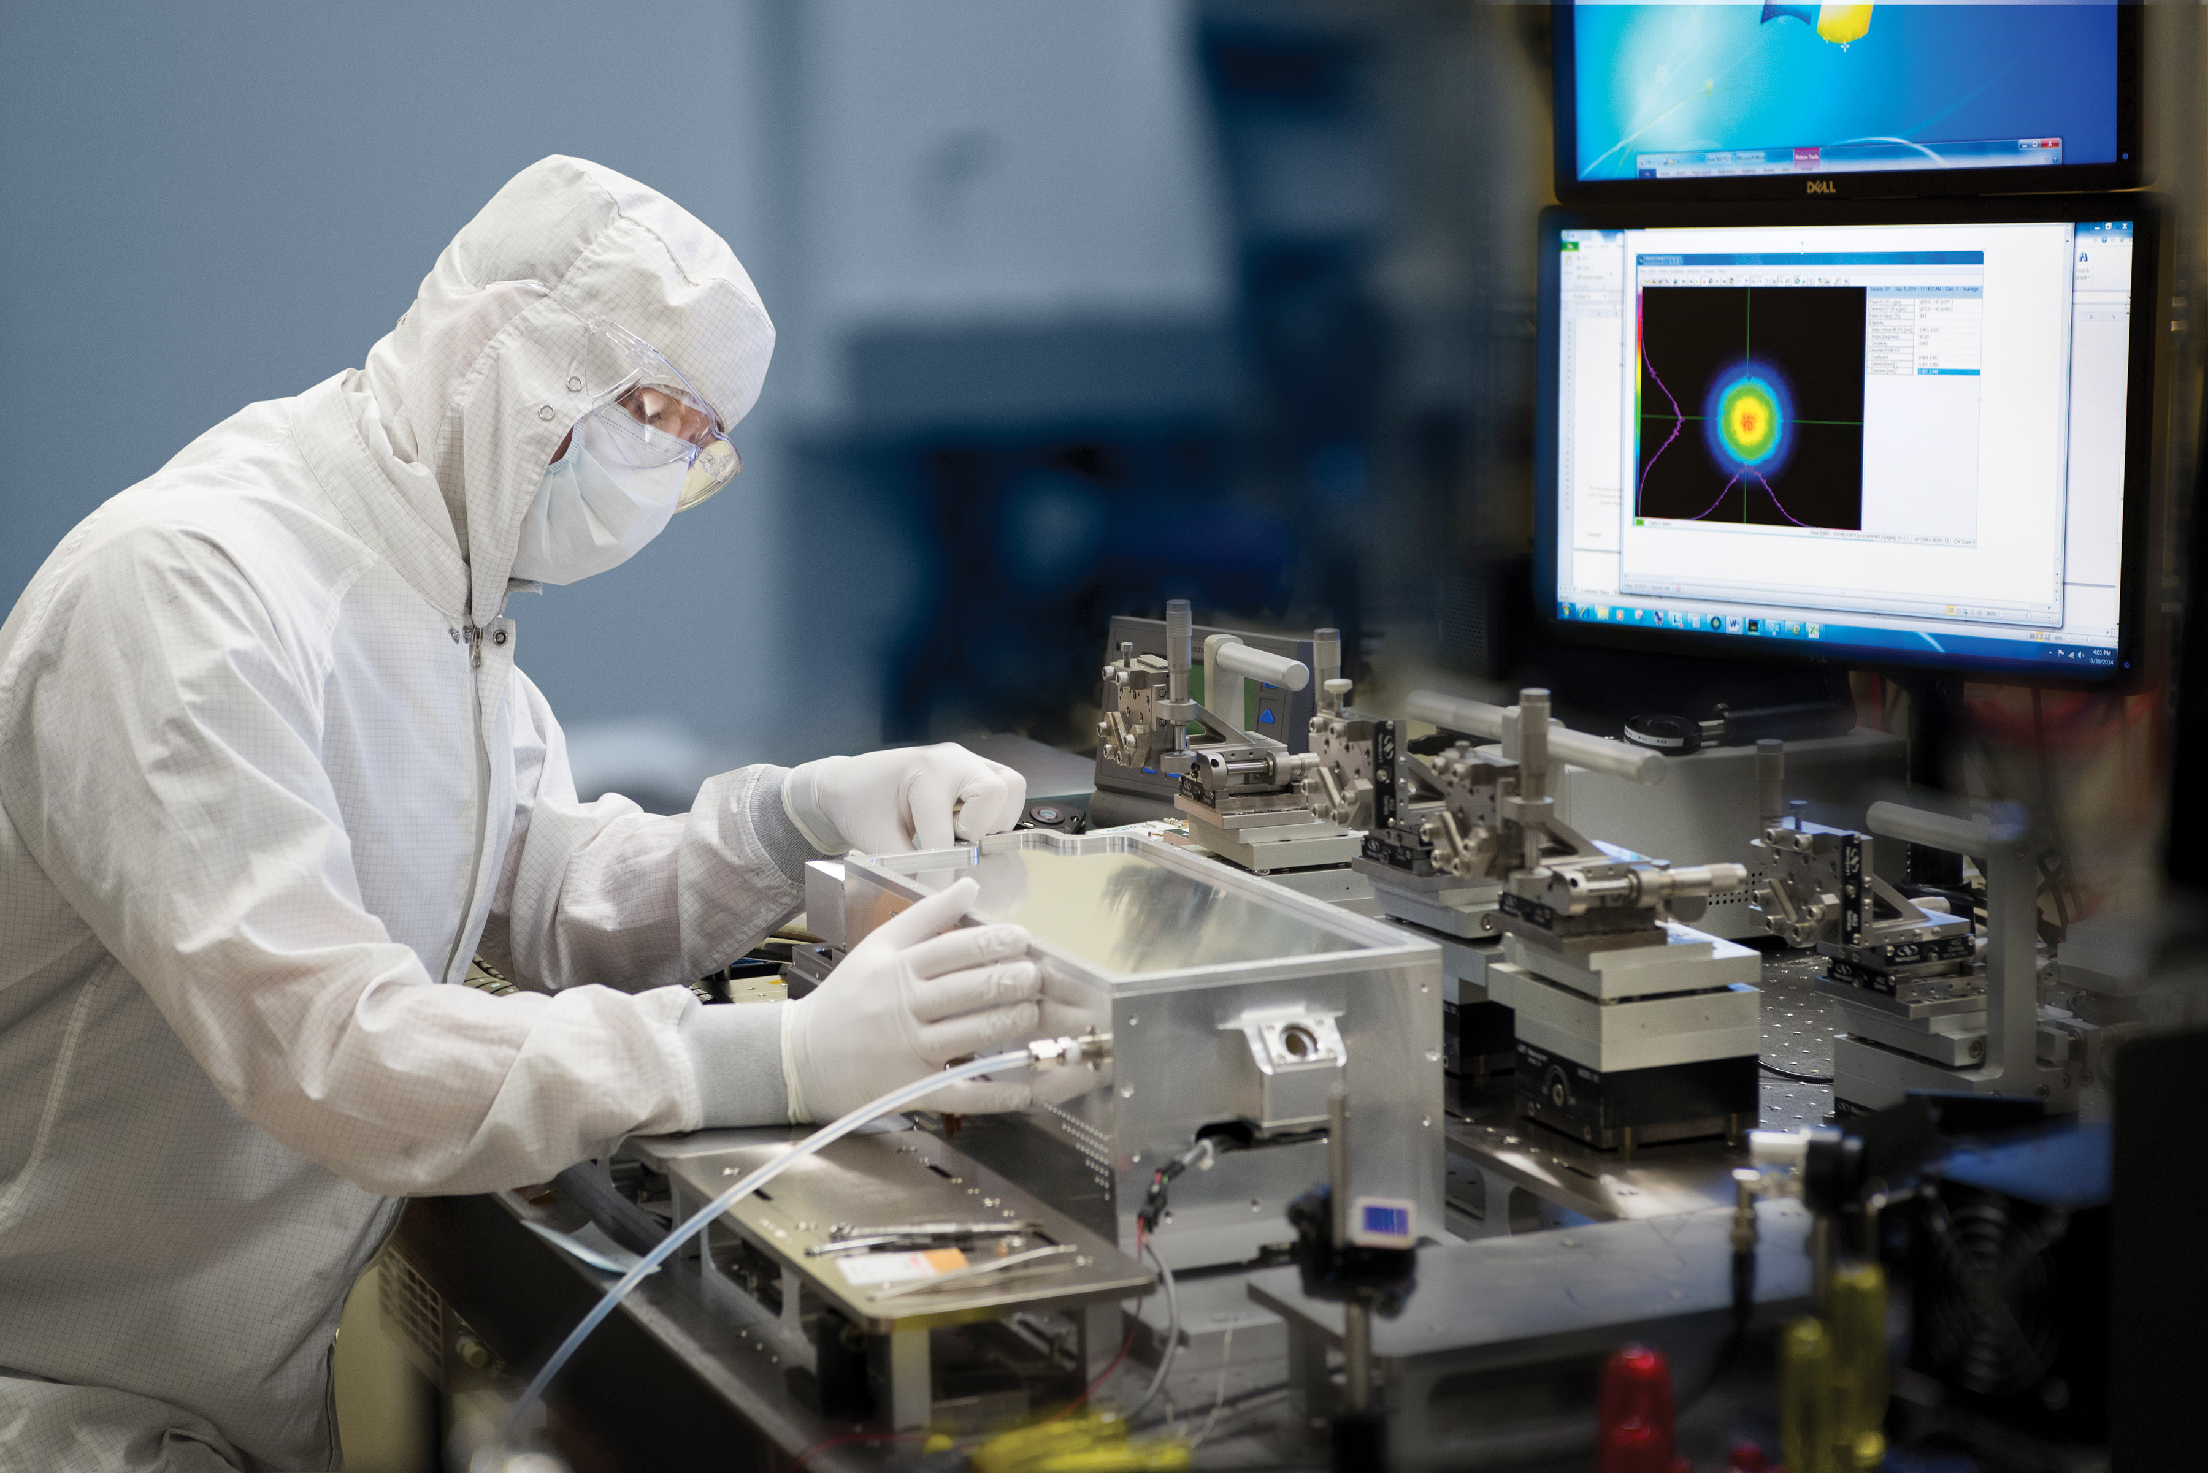
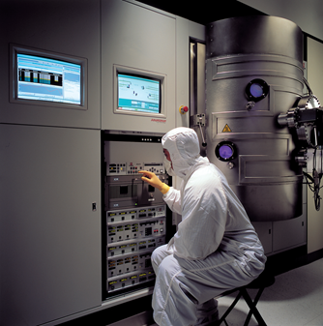
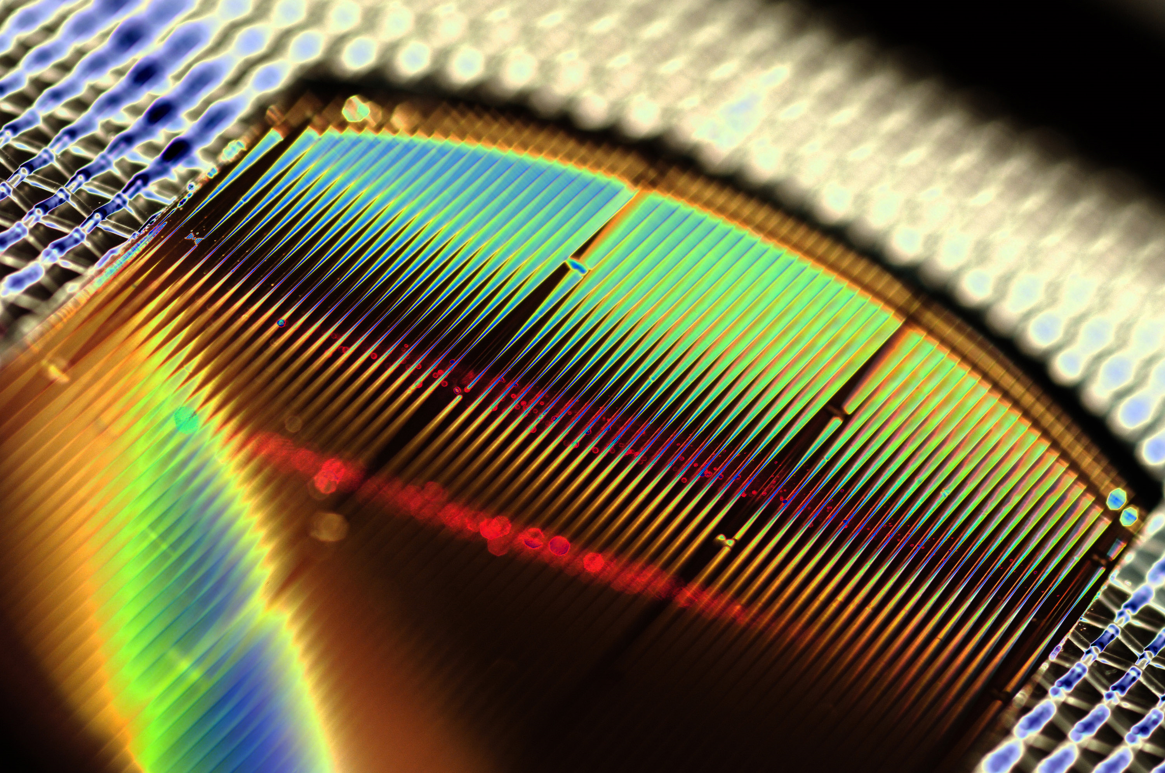
Coherent in Quantum
Coherent has been involved with Quantum Science for decades
Multiple technology platforms available to address Quantum 2.0
We are interested in cooperations to address commercially viable opportunities

Slide 6
THANK YOU
dirk.mueller@coherent.com & marco.arrigoni@coherent.com

